Slide 1

OFFICE SUPPLY DATA REPORT
BY
DATA ANALYST:
UBAH IKECHUKWU
OPEYEMI TAIWO
ADEOLA OGINNI

Slide 2
SALES REPORT CONTENT
EXECUTIVE SUMMARY
KEY FINDINGS/SOLUTIONS
RECOMMENDATION
CONCLUSION

Slide 3
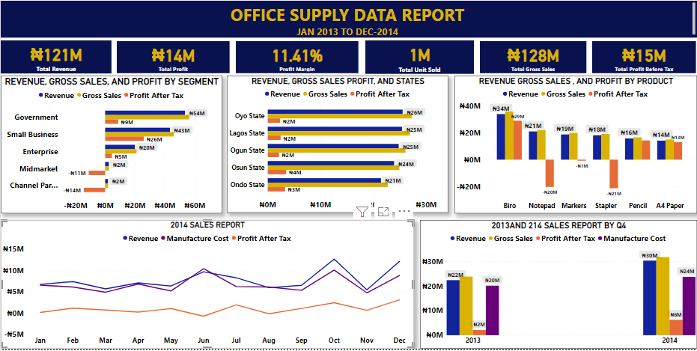
EXECUTIVE SUMMARY

Slide 4
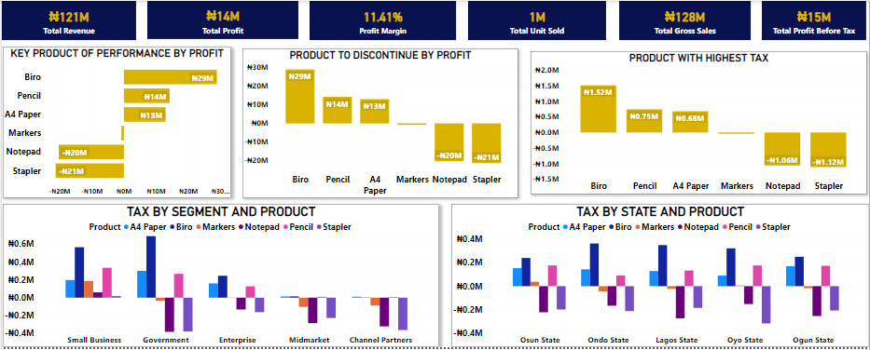

Slide 5






KEY FINDINGS
From Jan – 2011 to Dec – 2014
Total revenue of 121 Million was generated.
Total Profit of 14 Million was generated.
The Profit margin realized was 11.41% at the end of Dec-2014.
The Total Gross Sales realized was 128 Million .
Total profit before tax of 15 Million was generated.
1 million units of goods was sold from Jan-2013 to Dec-2014

Slide 6
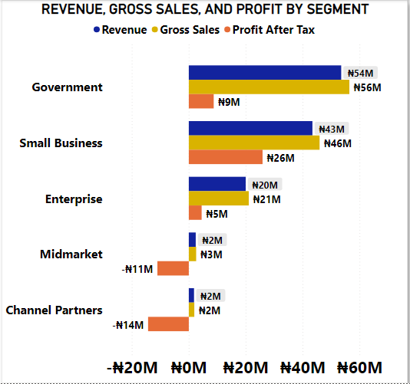
KEY FINDINGS/SOLUTION
INSIGHTS
Government the most revenue while channel partners made the least revenue.
Government made the most gross sales while channel partners made the least gross sales.
Small business have the highest based on profit after tax while channel partners made the least profit after tax (Loss).
RECOMMENDATION
The marketing team should come up with new strategies with the goal of increasing the quantity sold in channel partners in other to increase the revenue , gross sales and profit after tax

Slide 7
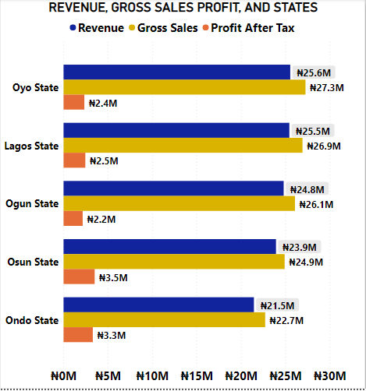
KEY FINDINGS/SOLUTION
INSIGHTS
Oyo state generated the highest revenue and gross sales.
Ondo state generated the least amount of revenue.
Osun state generated the highest profit after tax.
Ogun state made the least profit after tax.
RECOMMENDATION
Investigation should be carried out to know why Ondo state made the least revenue.
Investigation should be carried out to know why Ogun state made the least profit after tax.

Slide 8
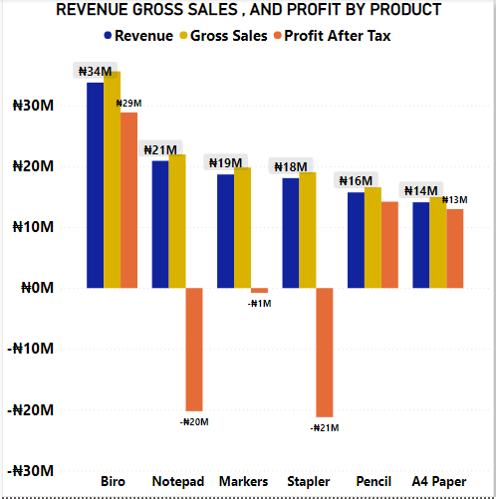
KEY FINDINGS/SOLUTION
INSIGHTS
The largest revenue was generated from the sales of biro product while A4 paper made the least revenue.
Biro also generate the highest profit after tax while stapler generated the least profit after tax.
RECOMMENDATION
Investigation should be carried out to know why A4 paper generated the least revenue .
Investigation should be carried out to know why stapler generate the least profit after tax.

Slide 9
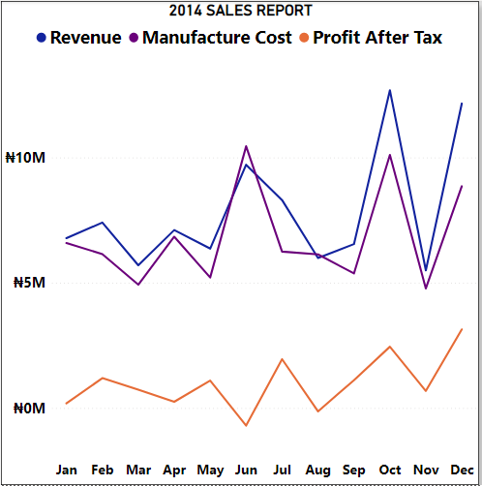
KEY FINDINGS/SOLUTION
INSIGHTS
The company generated the highest revenue growth in the month of October in 2014 while November had the greatest decline in 2014.
RECOMMENDATION
Investigation should be carried out to know why November had the least revenue generation.

Slide 10
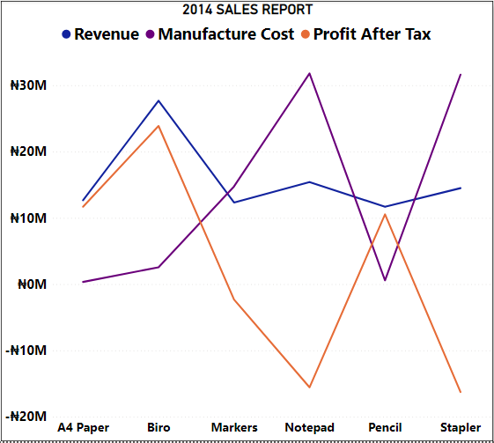
KEY FINDINGS/SOLUTIONS
INSIGHTS
A4 paper has a steady growth in terms of profit after tax while biro has the highest growth rate in terms of profit after tax. Maker has a steady decline or negative growth rate in terms of profit after tax . Notepad has a steady increase in terms of profit after tax. steady decline for stapler gives a negative value of profit after tax.
RECOMMENDATION
The marketing team should come up with new strategies with the goal of increasing the quantity sold in channel partners in other to increase the revenue , gross sales and profit after tax

Slide 11
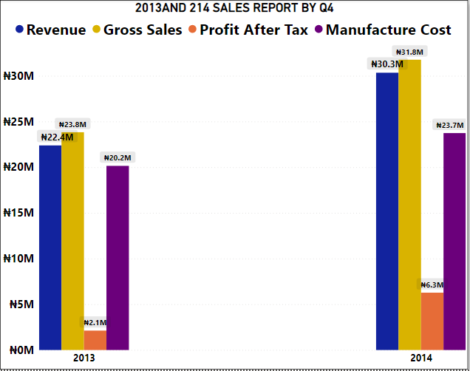
KEY FINDINGS/SOLUTION
INSIGHTS
There is an increase in revenue generation, gross sales, profit after tax in Q4 from 2013 to 2014.
The manufacturing cost used in the Q4 of 2014 was more when compared to 2013.
RECOMMENDATION
The manufacturing cost amount of 2013 Q4 need to be increase to generate more revenue , gross sales and profit

Slide 12
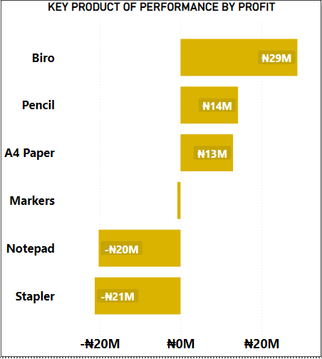
KEY FINDINGS/SOLUTION
INSIGHT
Biro is the driver of performance followed by pencil and A4 paper.
Notepad and stapler the product with least performance.
RECOMMENDATION
Investigation need to be carried out on the products (stapler and Notepad) to know why they have the least amount of profit after tax.

Slide 13
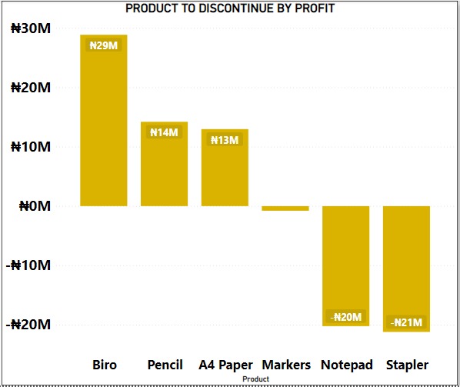
KEY FINDINGS/SOLUTION
INSIGHTS
Notepad and Stapler they both have a negative down turn due to profit generated but Stapler is the product with the lowest outcome.it has the highest negative outcome so it need to be discontinue.
RECOMMENDATION
The marketing team should come up with new strategies with the goal of increasing the quantity of Notepad and Stapler that are sold in other to increase profit after tax that will be generated.

Slide 14
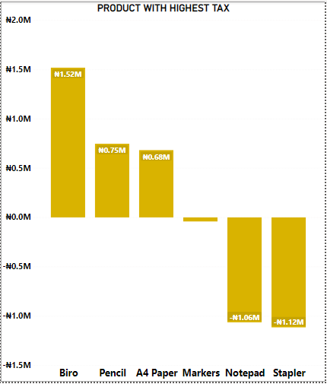
KEY FINDINGS/SOLUTION
INSIGHTS
Biro has the overall tax payment of (1.52M)
RECOMMENDATION
New steps and procedures need to be taken to reduce the amount of tax paid for biro.

Slide 15
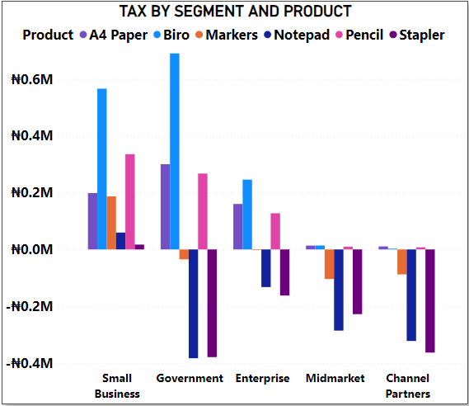
KEY FINDINGS/SOLUTION
INSIGHTS
Government and small business pay the highest tax on biro. While midmarket and channel product pay the least tax on biro.
RECOMMENDATION
Base on the insight government and small business need to come up with strategies to reduce the tax paid on biro.

Slide 16
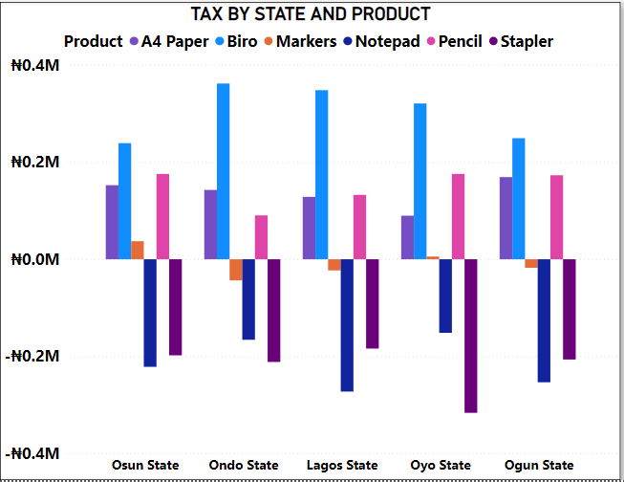
KEY FINDINGS/SOLUTION
INSIGHTS
In all states Biro is the product with the highest tax.
In Oyo state Stapler is the product with the lowest tax payment.
RECOMMENDATION
All states needs to come up with new strategies to reduce the tax paid on biro.

Slide 17
CONCLUSION
A diagnostic analytical approach need to be taken to get the causes resulting to decline in revenue and profit after tax.

Slide 18
THANK YOU

